Slide 1
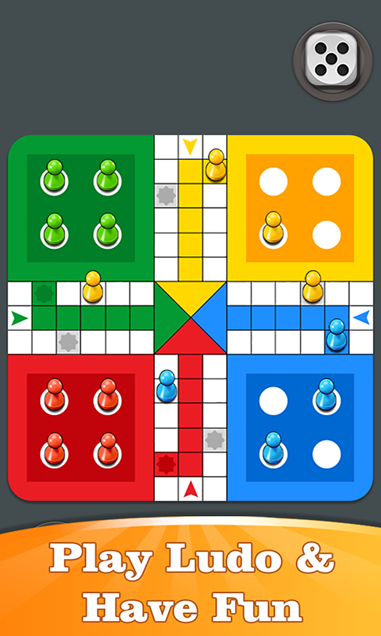
LUDO GAME
MINOR PROJECT(CUTM1906)
Name:- Soumya Ranjan Nayak
Reg.no:- 200301120175
Branch:- CSE
Sem:- 6th
Guided by:- Prof. Rajkumar Mohanta

Slide 2
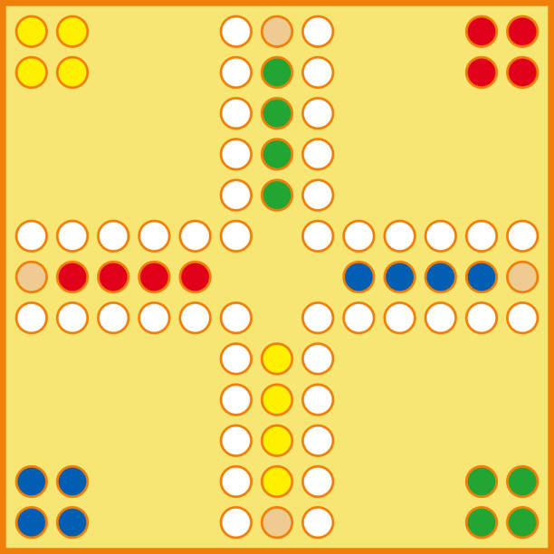
Content:
Introduction to Ludo Game
Key Elements of Ludo Game
Implementing Ludo Game in JavaScript
Challenges in Creating Ludo Game Using JavaScript
Benefits of Creating Ludo Game Using JavaScript
Conclusion

Slide 3

Introduction
Ludo is a popular board game that has been played for generations. It is a game of strategy and luck that can be enjoyed by people of all ages. The game is played on a board with four colored sections, each with four spaces. The object of the game is to move your pieces around the board and into your home section before your opponents do.
It is a strategy board game for two to four players, in which the players race their four tokens from start to finish according to the rolls of a single die.

Slide 4
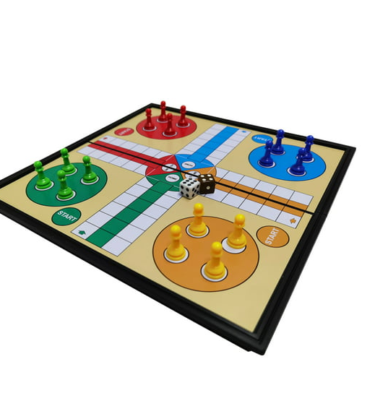
Key Elements of Ludo Game
There are several key elements of Ludo game that make it unique and interesting. These include the board, the pieces, the dice, and the rules. The board is divided into four colored sections, each with four spaces. The pieces are also colored and are moved around the board based on the roll of the dice. The dice is used to determine how many spaces the player can move their piece.
The rules of Ludo game are simple and easy to understand. Each player takes turns rolling the dice and moving their pieces around the board. The first player to get all their pieces into their home section wins the game.

Slide 5
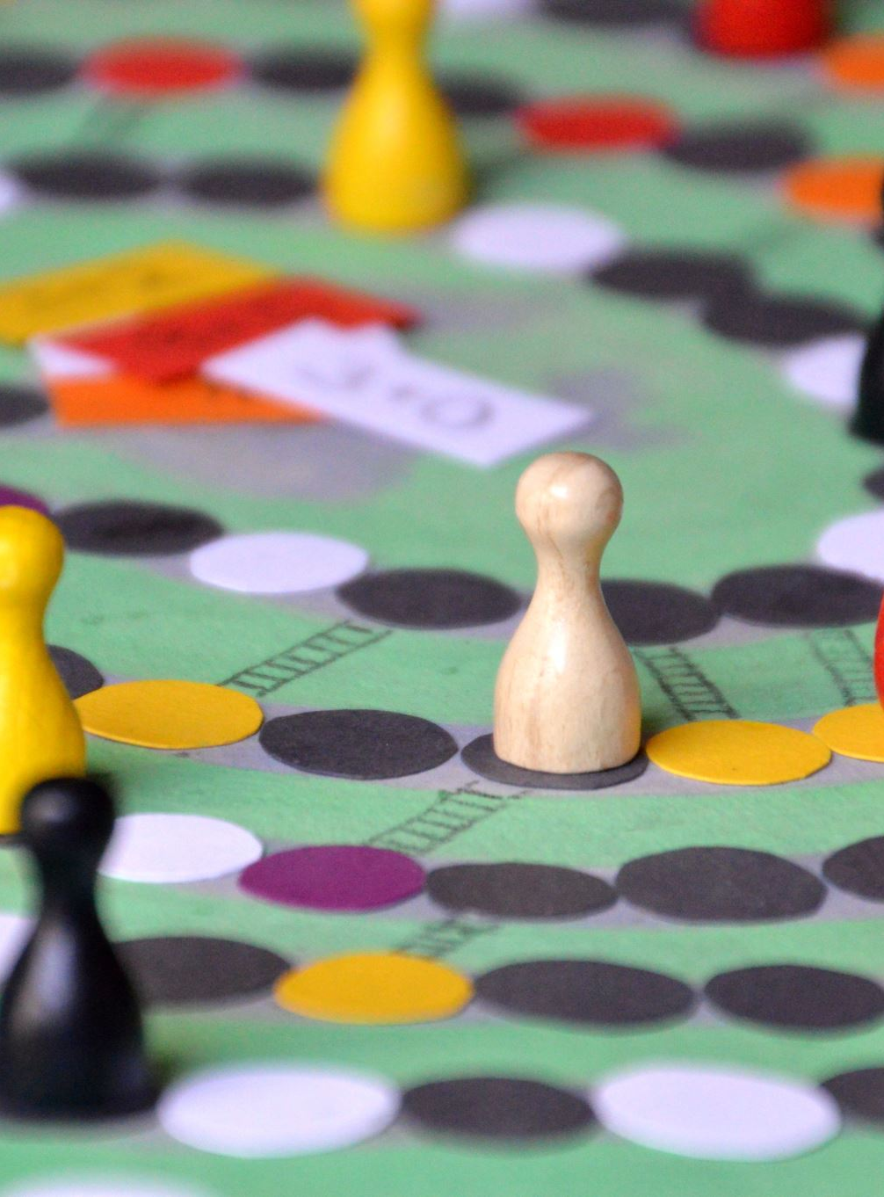
Implementing Ludo Game in JavaScript:
We need to first understand the basics of JavaScript programming language. Once we have a good understanding of JavaScript, we can start implementing the game logic. This includes creating the board, the pieces, and the rules.
We can use JavaScript to handle the user input and update the game state accordingly. For example, when a player rolls the dice, we can use JavaScript to generate a random number and move the player's piece accordingly. We can also use JavaScript to check if a player has won the game and display a message accordingly.

Slide 6

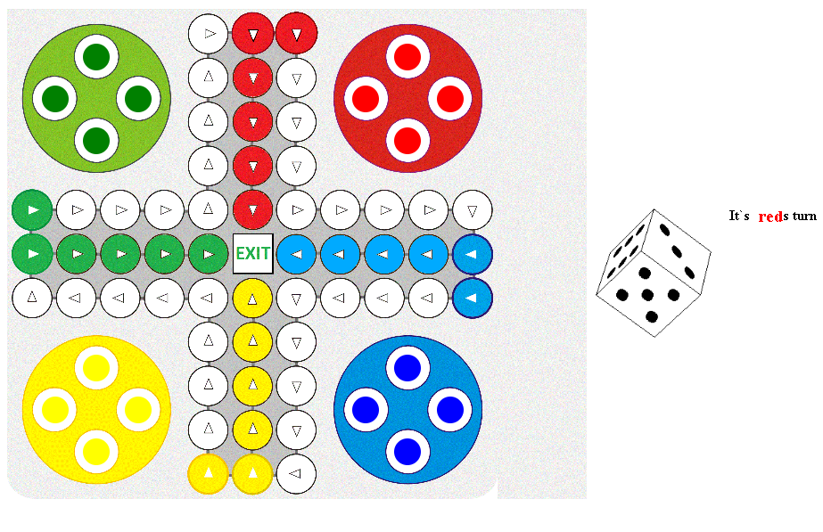
SNAPS

Slide 7
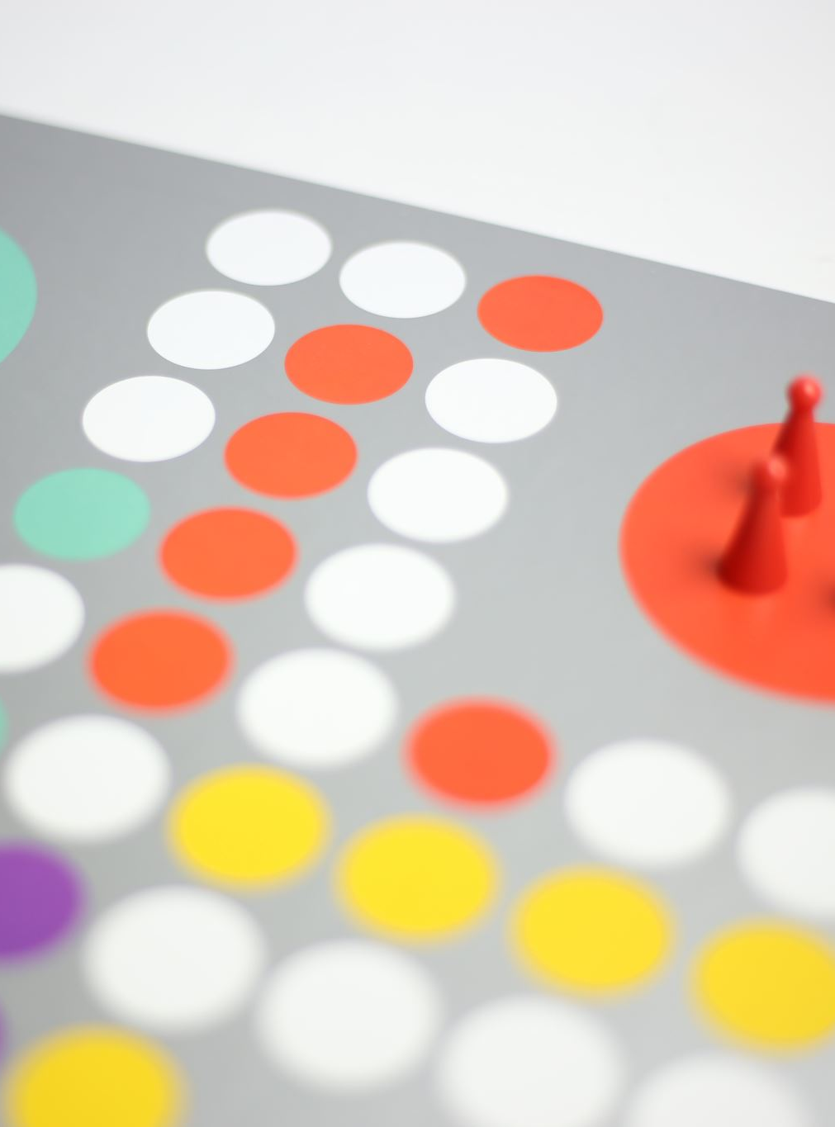
Benefits of Creating Ludo Game Using JavaScript
Creating a Ludo game using JavaScript can be a fun and rewarding experience. It allows us to learn about programming and game development while creating something that others can enjoy. It also helps us to improve our problem-solving skills and creativity.
In addition, creating a PowerPoint presentation on Ludo game using JavaScript can be a great way to showcase our skills and knowledge to others. It can be used as a portfolio piece or as a demonstration of our abilities to potential employers.

Slide 8
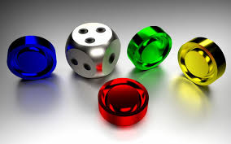
Conclusion:
In conclusion, creating a Ludo game using JavaScript can be a fun and challenging project. It requires a good understanding of JavaScript programming language and game development principles. However, the result can be a visually appealing and engaging presentation that showcases our skills and creativity.
By following the key elements of the game, implementing the game logic in JavaScript, and overcoming the challenges, we can create a Ludo game that is enjoyable for everyone. Whether we are creating it for personal enjoyment or as a professional project, the benefits of creating a Ludo game using JavaScript are numerous.

Slide 9

Thank you
Soumya Ranjan Nayak
200301120175@cutm.ac.in
Website link
https://ludogmae.s3.amazonaws.com/Ludo+game/Ludo-game.html

